Slide 1
Spring Boot Series – Day 16
Topic: Custom Login API (DTO + AuthenticationManager)
@CodeByHaindavi | #SpringWithMe

Slide 2
Why Custom Login Matters?
✔️ The default /login endpoint hides the entire authentication flow inside Spring Security internals, making it hard to customize or debug.
✔️ It accepts only form-encoded input and returns HTML responses, which makes it incompatible with modern JSON-based API standards.
✔️ A custom login API provides full control over the request and response structure, enabling clean integration with frontend apps and token-based systems like JWT.
@CodeByHaindavi | #SpringWithMe

Slide 3
Step-by-Step API Flow
✔️ Credentials are sent as a JSON payload using a LoginRequest DTO — clean and frontend-friendly.
✔️ The controller receives the DTO, extracts the values, and passes them for authentication — no form data, no clutter.
✔️ AuthenticationManager takes over, wrapping credentials inside a UsernamePasswordAuthenticationToken and verifying them internally.
✔️ On successful authentication, a signed JWT is generated and returned in the response — ready to authorize future requests.
@CodeByHaindavi | #SpringWithMe

Slide 4
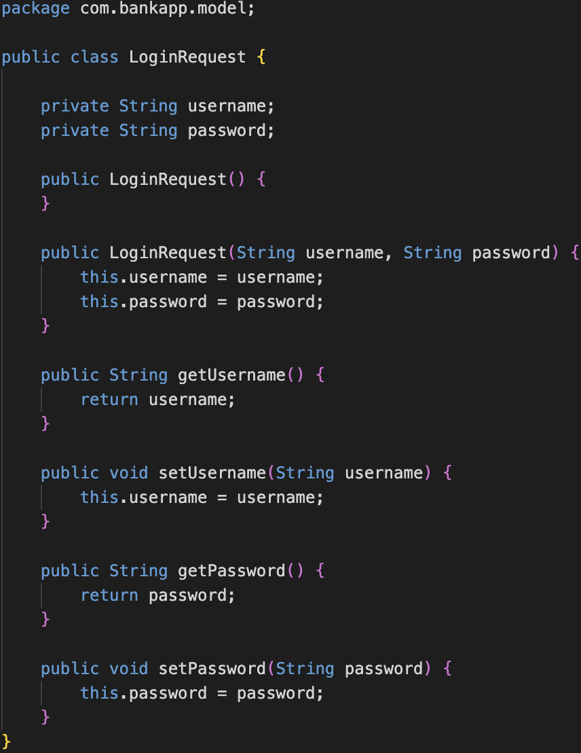
DTO Code – LoginRequest
✔️ The DTO contains just two fields: username and password — minimal and focused.
✔️ Acts as a structured input for the controller, replacing raw request parsing.
✔️ Improves code clarity, enforces validation, and keeps layers decoupled — making the login logic reusable across services.
@CodeByHaindavi | #SpringWithMe

Slide 5
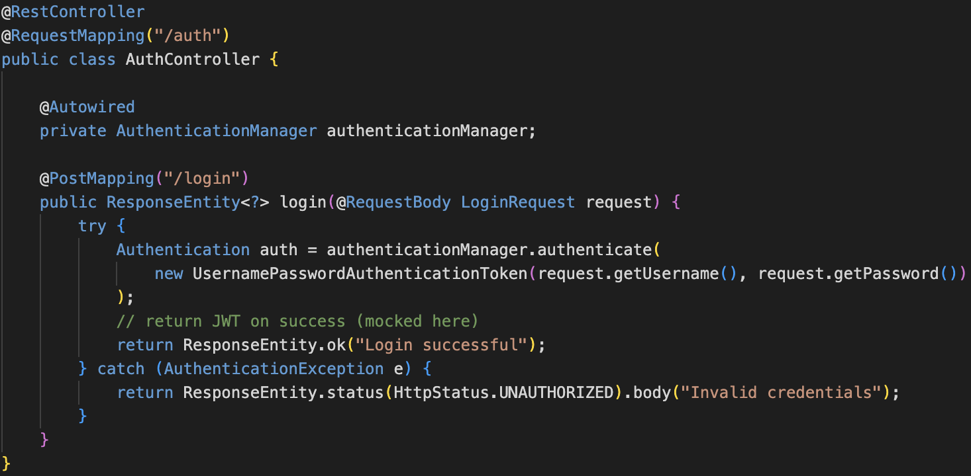
AuthController – Login Endpoint
✔️ The login endpoint is exposed at POST /auth/login — designed for API clients, not browser forms.
✔️ The controller method accepts a LoginRequest using @RequestBody — enabling JSON-based input.
✔️ Credentials are passed to AuthenticationManager.authenticate(...) — which triggers the actual authentication logic.
✔️ On success, a JWT is generated and returned; on failure, a clean error response is sent — no HTML errors, no ambiguity.
@CodeByHaindavi | #SpringWithMe

Slide 6
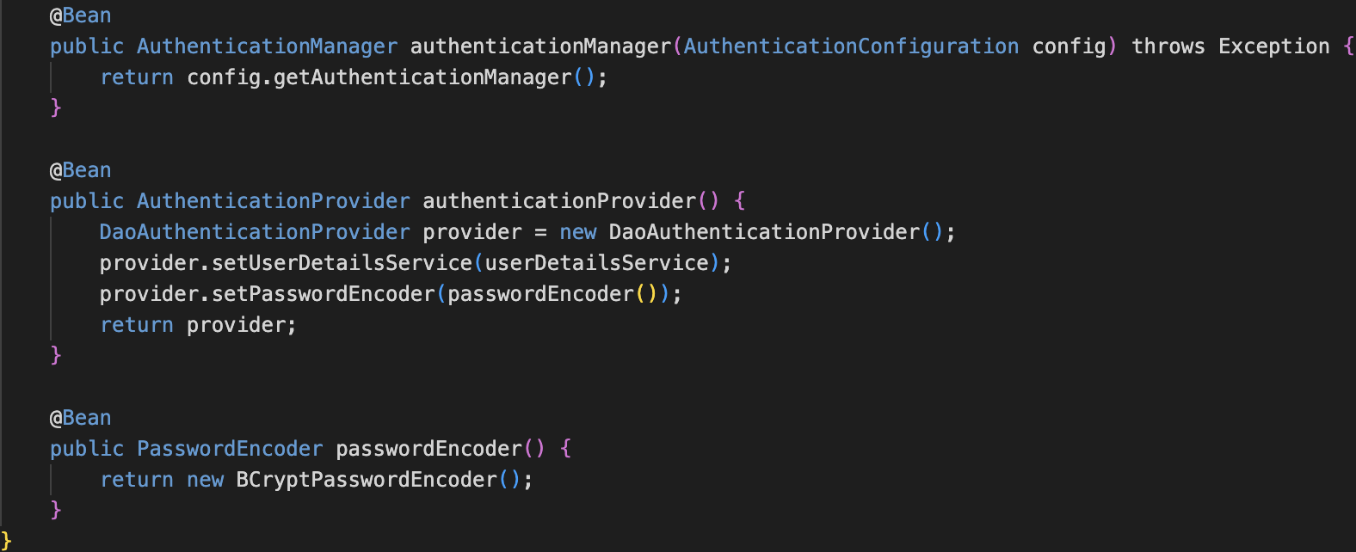
Common Pitfalls to Avoid
✔️ AuthenticationManager must be explicitly exposed as a @Bean — otherwise, injection fails at runtime.
✔️ Omitting @RequestBody breaks JSON input mapping — the DTO stays empty.
✔️ Without proper exception handling, Spring returns HTML error pages — useless for APIs.
✔️ Using HttpServletRequest directly couples the controller to servlet internals — instead of using a clean DTO.
@CodeByHaindavi | #SpringWithMe

Slide 7
Benefits of This Custom Flow
✔️ Builds a clean, JSON-driven handshake between frontend and backend — every field is defined, every response is predictable.
✔️ Cuts out the default form login flow — no redirections, no hidden parameters, just a proper API call.
✔️ Sends clear, structured error responses with relevant HTTP status codes — makes debugging and UI handling smooth.
✔️ Sets up a solid base for adding JWT, role checks, and custom security rules — without rewriting the controller logic.
@CodeByHaindavi | #SpringWithMe

Slide 8
📌 Hands-On Tip
✔️ Always declare AuthenticationManager as a @Bean in your SecurityConfig — Spring won't inject it automatically when using custom login.
✔️ Use @RequestBody with your LoginRequest DTO — without it, Spring silently fails to bind the JSON input, and the fields stay null.
✔️ Enable Spring Security debug logging during development — it reveals filter chain flow, auth failures, and password encoding mismatches.
✔️ Define a PasswordEncoder bean using BCryptPasswordEncoder — Spring won’t match credentials unless both sides are encoded the same way.
✔️ Use Postman to simulate frontend behavior — send a JSON payload with Content-Type: application/json to validate your endpoint setup.
✔️ Decode the generated JWT using tools like jwt.io — this helps verify the structure, expiration time, and embedded claims before moving to role-based access.
✔️ Keep DTOs like LoginRequest in a separate model or dto package — this keeps layers modular and improves reusability across microservices.
@CodeByHaindavi | #SpringWithMe

Slide 9
💼 Interview Insight
How is AuthenticationManager injected and used?
• AuthenticationManager is exposed manually using a @Bean inside SecurityConfig, because Spring doesn’t auto-configure it for custom login flows.
• It's injected into the controller and used to authenticate user credentials via authenticate(...), typically wrapped in a UsernamePasswordAuthenticationToken.
• This setup gives full control over the authentication process, allowing custom error handling, token generation, and clean JSON responses.
Why prefer DTO over HttpServletRequest in login?
• A DTO like LoginRequest gives a clean, typed structure for input — every field is explicitly defined and validated.
• Using HttpServletRequest ties the controller to servlet internals and forces you to manually parse request parameters — error-prone and messy.
• DTOs promote decoupling, support automatic validation with annotations, and make the code readable, testable, and reusable across layers.
@CodeByHaindavi | #SpringWithMe

Slide 10
📌 Recap – Day 15
🔐 Authorization isn’t just about who’s logged in — it’s about what their token says they’re allowed to access.
📦 JWT allows you to embed roles, scopes, and access metadata directly into the token — no database lookups, no sessions.
🧠 Spring Security reads these claims and enforces access rules using annotations and config — declaratively and reliably.
🚀 The result: APIs that are stateless, secure, and ready for real-world scale — without sacrificing control.
👉 Coming up next: Custom Login API (DTO + AuthenticationManager)
@CodeByHaindavi | #SpringWithMe

